Slide 1

Writing business messages and documents
- Rimma Quadros

Slide 2
Preparation process of effective business messages
Identify your purpose – Reason for the message and creation of goodwill
Analyse your audience – See message from audience point of view
Choose your ideas- select from many ideas to create a message
Collect your data- to support your ideas , check names, address, facts etc.
Organize your message- maintain the order

Slide 3
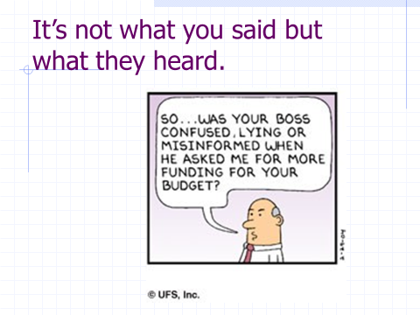

Slide 4
“You can have all the great ideas in the world and if you can’t communicate, nobody will hear them.”

Slide 5
Bryan Garner, author of The HBR Guide to Better Business Writing. Effective writing “is not a gift that you’re born with,” he says. “It’s a skill that you cultivate.”

Slide 6
Business Letter

Slide 7
Format
Date: Use month, day, year format, e.g., March 3, 2012 or 3 March 2012.
Sender's Address: It is a good idea to include sender's email and url, if available. ...
Inside Address: Use full name. ...
Salutation: Be sure to use a colon at the end of the name, not a comma as in personal letters.
Final notations: Two lines below your typed signature. For example, if you're sending copies of the letter to other people, you may type cc:,followed by the alphabetically listed names of those receiving the letter.

Slide 8
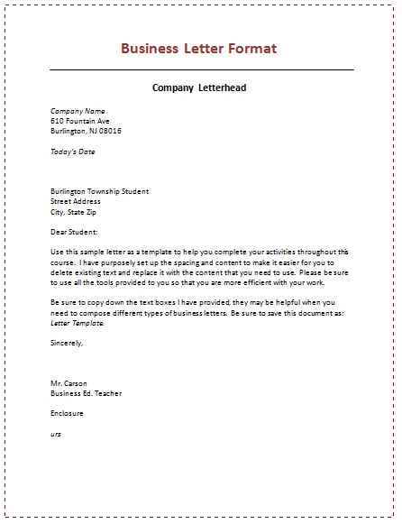

Slide 9
Recipient address: Three to six lines below the dateline, flush left. The recipient address is composed of:
Addressee’s courtesy title and full name
Addressee’s business title
Business name
Street address
City, state, and zip code

Slide 10
Body: Starts one line below the greeting. The body of the letter contains whatever you have to say.
Complimentary close: Two lines below the last line of the body of the letter, flush left or centered.
All the following closes are appropriate in business letters when you don’t know the addressee: Yours truly, Very truly yours, Yours very truly, Sincerely, Yours sincerely, Sincerely yours.
Signature: Immediately below your complimentary close, you hand-write your signature.

